Slide 1
Online Advertising & Search Business Introduction

Slide 2
Session Overview
Advertising Channels
Online vs Offline Advertising
Types of Online Advertising
Display ads
Examples
Advantages and Disadvantages
Native ads
Examples
Advantages and Disadvantages
Search ads
Examples
Advantages and Disadvantages
Why Advertise using Search?
Search Advertising Stakeholders
Advantages and Disadvantages
Examples
Stakeholders

Slide 3
Advertising Channels
An advertising channel is a medium used by a company to advertise their products and inform and market to customers
Online and Offline Channels
Online Channels pool in visitors who enter the marketplace through online sources such as search engines, Internet ads, referring domains, or email campaigns
Offline Channels apply to visitors who enter the marketplace through offline sources such as television ads, newspapers ads, or magazine advertisements
Advertising
Channels
Display
Banner
Native
News paper
Online
Offline
Search
Channels
Channels
Magazine
Email
TV/Radio
Social Media

Slide 4
Online vs Offline Advertising Advantages
Lower costs and higher returns on investment (ROI)
Provides extensive capabilities to measure the effectiveness of ads in near realtime
Wide variety of messaging options (images, videos, audio, relevant web links, etc.)
More precise and effective audience targeting options (geography, demographic, time of display, etc.)
Coverage of the entire pool of online audiences
Immediate deployment upon campaign and ad design completion

Slide 5
Online Advertising Types
Online Advertising
Textual Advertising
Ads displayed in a text format with a link to Customer’s landing page
Native Advertising*
Ads that blends with the experience on a web page is displayed based on user intent
Search Based Advertising
Ads displayed based upon keywords searched through an online search bar
Multimedia Rich Advertising
Interactive ads
Display Advertising
(Banner/Flash/Games/Pop-Ups)
Can be a double edged sword- Attractive or Distracting
*Content ads is another Bing Ads offering which shows ads based on the content of a page, but has been deprecated

Slide 6
What is Display Advertising?
Display advertising is a type of online advertising that comes in several forms, including banner ads, rich media and more
Unlike text-based ads, display advertising relies on elements such as images, audio and video to communicate advertising messages
Notes:
Crawler is an Internet bot that systematically browses the World Wide Web, typically for the purpose of Web indexing

Slide 7
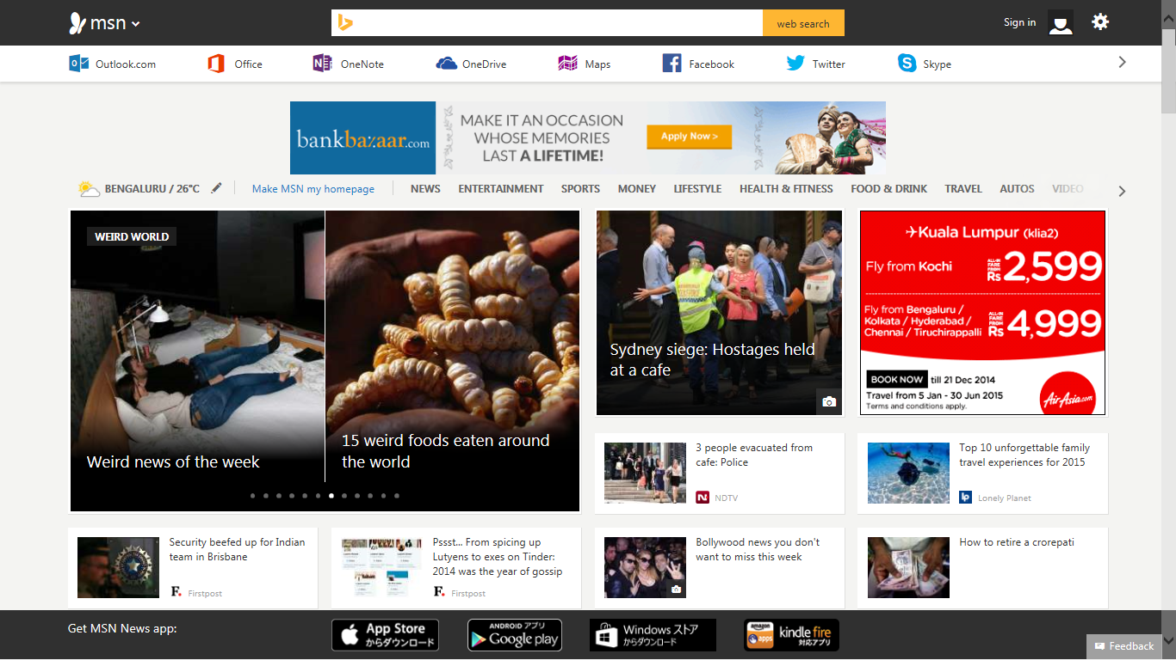
Display Advertising Example
Display Ad
Notes:
Crawler is an Internet bot that systematically browses the World Wide Web, typically for the purpose of Web indexing

Slide 8
Display Advertising Advantages and Disadvantages
Advantages
Visually appealing to end users as compared to search or content ads
Reserved impressions are extremely effective in product branding
Enables audience targeting through demographic methods
It has been proven that Display Advertising promotes & increases Search and Content Ad clicks
Advances in broadband connectivity has enabled richer more attractive display ads
Disadvantages
Costly when compared to other forms of online advertising
Very poor ad click-through rates
Hard to track direct return on investment (ROI)
Less flexible than search or content ads where advertisers can decrease their cost (bids) as ROI goes down
Some end user view display ads as a nuisance which might drive negative perceptions

Slide 9
What are Native Ads?
Bing Native Ads is a native offering optimized for search advertisers, which expands the reach of Bing Ads platform to target user intent even outside search
These are also called “Intent Ads”, in that they combine intent signals from users on the publisher page with native experiences on that page which are both natural (native) and relevant
The most powerful intent signals on the web include:
users’ interests expressed by their prior search queries
intent signals from the content of the experience in which the users are at any given point
user actions like looking for products or taking actions on advertiser sites
Notes:
Crawler is an Internet bot that systematically browses the World Wide Web, typically for the purpose of Web indexing

Slide 10
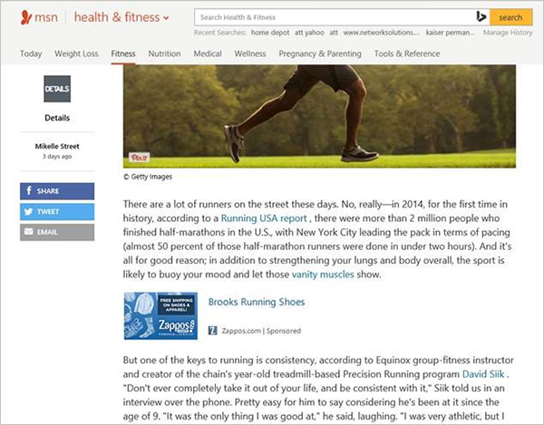
Native Ads Example – on articles
Native ad on the “Health” vertical in MSN
Notes:
Instructor Notes:
Advantages
Advertisements are more relevant compared to banner or display ads which leads to higher clicks
Provide information and transaction capabilities to customers wherever and whenever they are ready to buy a product or service
Advertisers not required to set up their own website for advertisements
Disadvantages
Content ads are completely based on the keywords picked up by the crawler- might face poor relevancy
Advertisements displayed are based on bid, CTR, relevancy etc .However the advertisement finally displayed may not appeal to the users interest
Located in a single Ad unit and is textual hence may not capture the attention of the user
Location of the ad unit may also not be an optimum location on the webpage

Slide 11
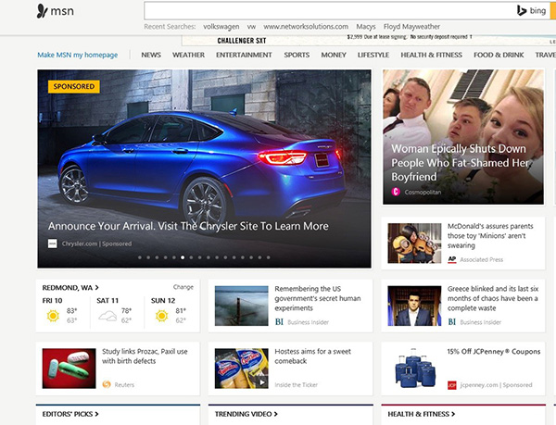
Native Ads Example – on the homepage
Native ad on the MSN HomePage
Notes:
Instructor Notes:
Advantages
Advertisements are more relevant compared to banner or display ads which leads to higher clicks
Provide information and transaction capabilities to customers wherever and whenever they are ready to buy a product or service
Advertisers not required to set up their own website for advertisements
Disadvantages
Content ads are completely based on the keywords picked up by the crawler- might face poor relevancy
Advertisements displayed are based on bid, CTR, relevancy etc .However the advertisement finally displayed may not appeal to the users interest
Located in a single Ad unit and is textual hence may not capture the attention of the user
Location of the ad unit may also not be an optimum location on the webpage

Slide 12
Native Advertising Advantages and Disadvantages
Advantages
Strong ad relevance matched to consumer intent - Ads are delivered to a highly targeted, relevant audience using a variety of signals, such as search history, site remarketing and page content
Competitive ROI - Strong consumer intent signals helps advertisers get only high-quality customers. Together, these features help you get qualified customers and more conversions
In addition to matching intent signals, Bing Native Ads offer the same advanced targeting or bid boosting capabilities available from Bing Ads including location, device type, time of day, day of week, and site remarketing
Disadvantages
Available only for some markets (US, UK, AU, CA)
Lower volume compared to search offering – this limits the ROI for advertisers
Still in beta phase – not all advertisers can adopt Native Ads, and need to be enabled for Native Ads by the platform
Faces stiff competition from Native offerings from other platforms (Taboola, Outbrain etc.)

Slide 13
What is Search Based Advertising?
Advertisements are displayed on a search page based on the search term (keywords) entered in a search box
Search Ads are selected through machine learning algorithms that rank eligible ads inventory based upon multiple factors
Ads are displayed in two parts of the web page
Main line (High ranking)
Side Bar (Low ranking)
Maximum number of displayed ads are:
Main line is 4
Side Bar is 12
Search engines networks operate running auctions to sell ads according to bids received for keywords or phrases
Advertiser only pay when their ads are clicked
At present Microsoft displays search ads on MSN homepage, toolbar, DNS error ,MSN channels etc.
Notes:
Ranking : Each ad is assigned a rank based on its performance and the amount advertiser is willing to spend to display it. The higher the ranking, more is the chance of the ad getting displayed

Slide 14
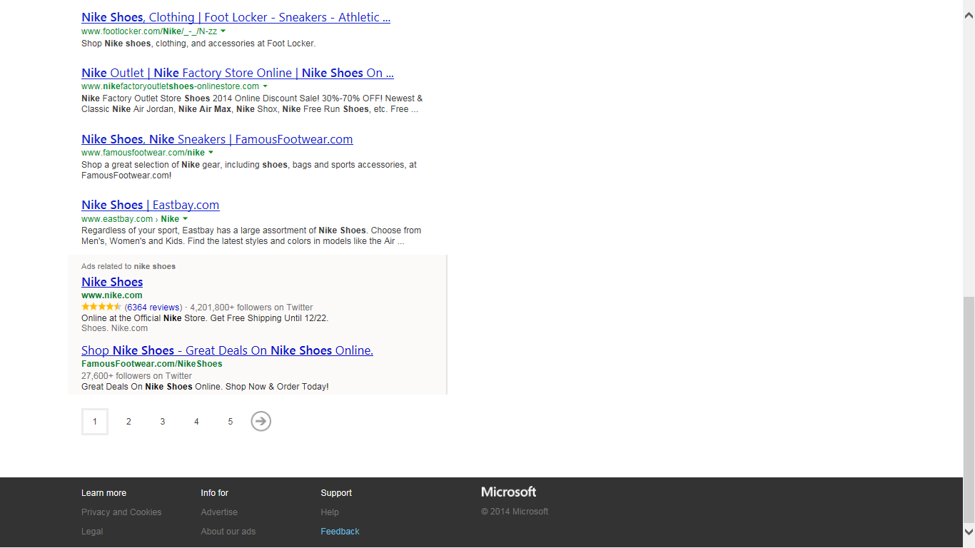
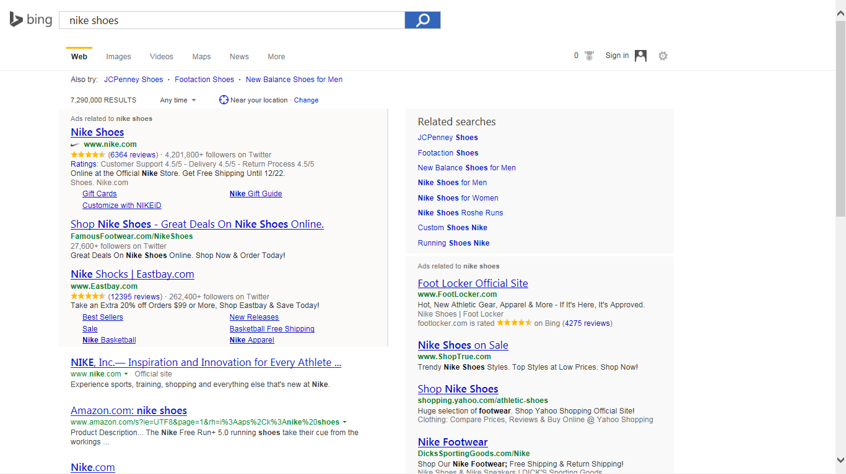
Search Ads Examples

Slide 15
Search Advertising - Advantages and Disadvantages
Advantages
Reaches target audiences when they are looking for products, thus having high purchase intent
Ensures that ads are only shown when searchers are searching for relevant products
Advertisers are not required to set up their own website for advertisements
Consumers can identify and compare purchasing options before making a purchasing decision
Disadvantages
Advertisements displayed are based its past performance and relevancy to the user’s search query. However the advertisement finally displayed may not appeal to the users interest
Located in a single Ad unit and is textual hence may not capture the attention of the user Side rail or bar advertisements may not capture the attention of the user
Companies with a lower budgets, or a narrower range of products, may be not be able to compete with larger competitors
Since Pay Per Click has become popular due to its effectiveness, it is costlier than other channels. Because it is based on competitive bids it can get expensive

Slide 16
Why Advertise Using Search?
Affordable
User-friendly
ROI
Higher Return on Investment
Better targeting
Expandable audience coverage
Extensive performance metrics
Ease of setting and managing campaigns
Always On
Active Audience
User friendly
Active Audience
Better
Targeting
Always On
Qualified Leads
Ease of Business
Expandable audience coverage
Handy
performance analysis
Notes:
Top 10 advantages of search marketing:
Affordable – with cost per clicks starting at £0.05, even small business can afford to test the waters without a large initial investment
Higher ROI – It’s a cost per click model. If no one visit’s your site, you do not pay for placement. You only pay for actual traffic
Better Targeting – You can choose keywords that describe your product or service to ensure you only appear for specific queries. In addition, Your ads can appear for all searches or you can refine your audience. Microsoft adCenter offers the strongest range of targeting including Time of day/day of week, location and proximity, demographics (age and gender), device type (mobile or PC)
Expandable audience coverage - As your business grows, so can your search marketing campaign. You can spend as much or as little as you can afford
Handy performance analysis - from tracking clicks to tracking sales, you can pull a range of reports that tell you where your account is performing well and where there are opportunities to improve
Ease of Business – setting up a search campaign is easy, although becoming an expert may take some time
Always on – You can run a search campaign for as long as you like, there is no time limit
Active Audience – as with directories, search results are displayed to users who are actively searching for your product or service and are there fore more likely to purchase
Control – you have the flexibility to change your campaign as you go along by adding keywords, writing new ads or amending bids
Disadvantages:
Advertisements displayed are based on bid, CTR, relevancy .However the advertisement finally displayed may not appeal to the users interest
Located in a single Ad unit and is textual hence may not capture the attention of the user
Side rail advertisements may not capture the attention of the user.
For companies with a lower budget or a narrower range of products on which to increase lifetime value it may be not possible to compete.
Since Pay Per Click has become popular due to its effectiveness, it is competitive and because it is based on competitive bids it can get expensive

Slide 17
Search Advertising Stakeholders
Publisher
(Ex: Bing.com)
Search Results + Ad Results
Audience
(User)
Query (Transaction, Information, Navigation)
Query
Platform
(Ex: Bing Ads)
Ad Results
Revenue
Advertiser Inventory
(Ex: Ad Copy, Keyword etc.)
What does each stakeholder
get by being in this system?
Revenue
Advertiser
Clicks/Conversions
Notes:
Top 10 advantages of search marketing:
Affordable – with cost per clicks starting at £0.05, even small business can afford to test the waters without a large initial investment
Higher ROI – It’s a cost per click model. If no one visit’s your site, you do not pay for placement. You only pay for actual traffic
Better Targeting – You can choose keywords that describe your product or service to ensure you only appear for specific queries. In addition, Your ads can appear for all searches or you can refine your audience. Microsoft adCenter offers the strongest range of targeting including Time of day/day of week, location and proximity, demographics (age and gender), device type (mobile or PC)
Expandable audience coverage - As your business grows, so can your search marketing campaign. You can spend as much or as little as you can afford
Handy performance analysis - from tracking clicks to tracking sales, you can pull a range of reports that tell you where your account is performing well and where there are opportunities to improve
Ease of Business – setting up a search campaign is easy, although becoming an expert may take some time
Always on – You can run a search campaign for as long as you like, there is no time limit
Active Audience – as with directories, search results are displayed to users who are actively searching for your product or service and are there fore more likely to purchase
Control – you have the flexibility to change your campaign as you go along by adding keywords, writing new ads or amending bids
Disadvantages:
Advertisements displayed are based on bid, CTR, relevancy .However the advertisement finally displayed may not appeal to the users interest
Located in a single Ad unit and is textual hence may not capture the attention of the user
Side rail advertisements may not capture the attention of the user.
For companies with a lower budget or a narrower range of products on which to increase lifetime value it may be not possible to compete.
Since Pay Per Click has become popular due to its effectiveness, it is competitive and because it is based on competitive bids it can get expensive

